Slide 1
U18AII5201 CLOUD ARCHITECTURE

Slide 2
Course Objectives:
To make students understand the concept of cloud computing.
To have knowledge on the various issues in cloud computing
To understand the functional relationship between cloud computing and stakeholders
To appreciate the emergence of cloud as the next generation computing paradigm.

Slide 3
Course Outcomes: After successful completion of this course, the students can
CO 1: Analyze the main concepts, key technologies, strengths and limitations of cloud
CO 2: Analyze and understand various queuing models
CO 3: To understand and use the architecture of compute and storage cloud, service and delivery models
CO 4: Apply the core issues of cloud computing such as resource management and security

Slide 4
QUEUEING MODELS
Layered Cloud Architecture Design – NIST Cloud Computing Reference Architecture – Public, Private and Hybrid Clouds - laaS – PaaS – SaaS – Architectural Design Challenges – Cloud Storage – Storage-as-a-Service – Advantages of Cloud Storage – Cloud Storage Providers – S3.

Slide 5
Layered Cloud Architecture Design
Transparency, scalability, security and intelligent monitoring are some of the most important constraints which every cloud infrastructure should experience.
The above is ensured using the layered approach in cloud architecture
Architecture of cloud computing is the combination of both SOA (Service Oriented Architecture) and EDA (Event Driven Architecture).
Client infrastructure, application, service, runtime cloud, storage, infrastructure, management and security all these are the components of cloud computing architecture.

Slide 6
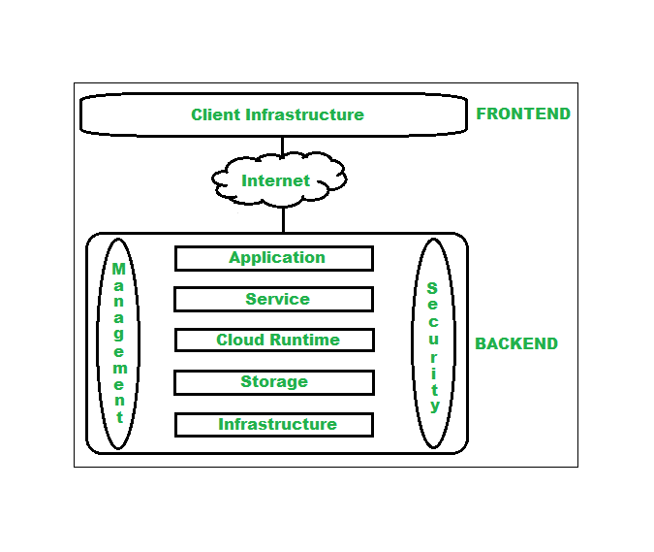
Layered Cloud Architecture Design
Cloud Computing Architecture : The cloud architecture is divided into 2 parts i.e.
Frontend
Backend

Slide 7
Layered Cloud Architecture Design
Transparency, scalability, security and intelligent monitoring are some of the most important constraints which every cloud infrastructure should experience.
The above is ensured using the layered approach in cloud architecture
Cloud Computing Architecture : The cloud architecture is divided into 2 parts i.e.
Frontend
Backend

Slide 8
Layered Cloud Architecture Design
1. Frontend : Frontend of the cloud architecture refers to the client side of cloud computing system. Means it contains all the user interfaces and applications which are used by the client to access the cloud computing services/resources. For example, use of a web browser to access the cloud platform.
Client Infrastructure – Client Infrastructure is a part of the frontend component. It contains the applications and user interfaces which are required to access the cloud platform.
In other words, it provides a GUI( Graphical User Interface ) to interact with the cloud.

Slide 9
Layered Cloud Architecture Design
2.Backend Backend refers to the cloud itself which is used by the service provider. It contains the resources as well as manages the resources and provides security mechanisms. Along with this, it includes huge storage, virtual applications, virtual machines, traffic control mechanisms, deployment models, etc.
Application:Application in backend refers to a software or platform to which client accesses. Means it provides the service in backend as per the client requirement.
Service:Service in backend refers to the major three types of cloud based services like SaaS, PaaS and IaaS. Also manages which type of service the user accesses.
Runtime Cloud:Runtime cloud in backend provides the execution and Runtime platform/environment to the Virtual machine.
Storage:Storage in backend provides flexible and scalable storage service and management of stored data.

Slide 10
Layered Cloud Architecture Design
Infrastructure: Cloud Infrastructure in backend refers to the hardware and software components of cloud like it includes servers, storage, network devices, virtualization software etc.
Management: Management in backend refers to management of backend components like application, service, runtime cloud, storage, infrastructure, and other security mechanisms etc.
Security: Security in backend refers to implementation of different security mechanisms in the backend for secure cloud resources, systems, files, and infrastructure to end-users.
Internet: Internet connection acts as the medium or a bridge between frontend and backend and establishes the interaction and communication between frontend and backend.

Slide 11
Layered Cloud Architecture Design
Benefits of Cloud Computing Architecture :
Makes overall cloud computing system simpler.
Improves data processing requirements.
Helps in providing high security.
Makes it more modularized.
Results in better disaster recovery.
Gives good user accessibility.
Reduces IT operating costs.

Slide 12
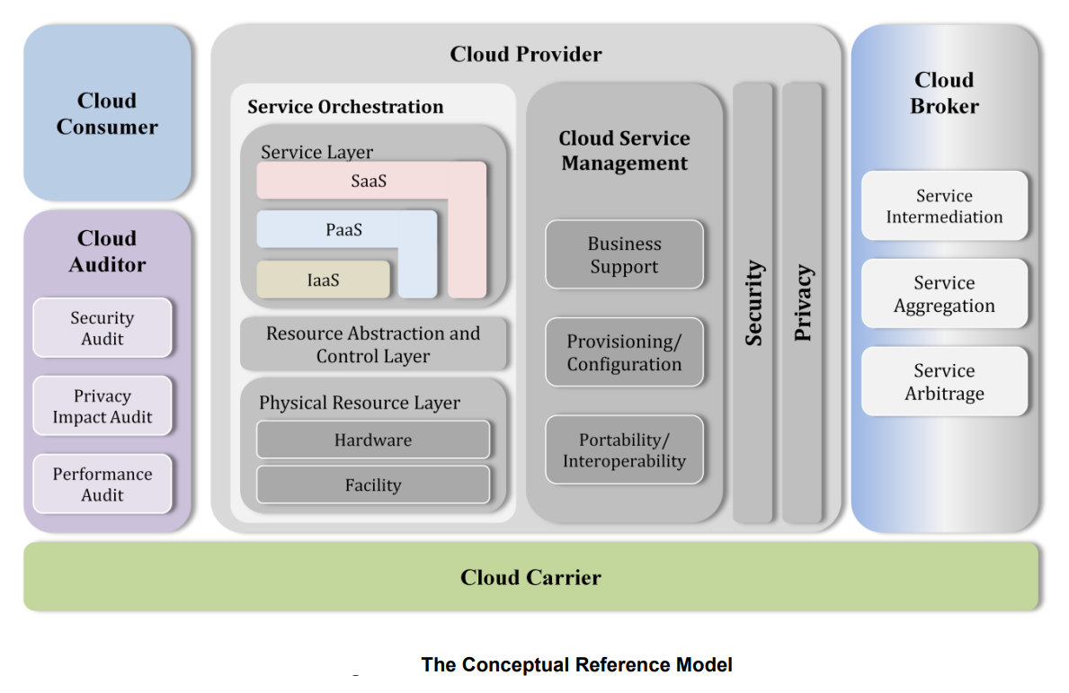
NIST Cloud Computing Reference Architecture
Cloud Computing Reference Architecture

Slide 13
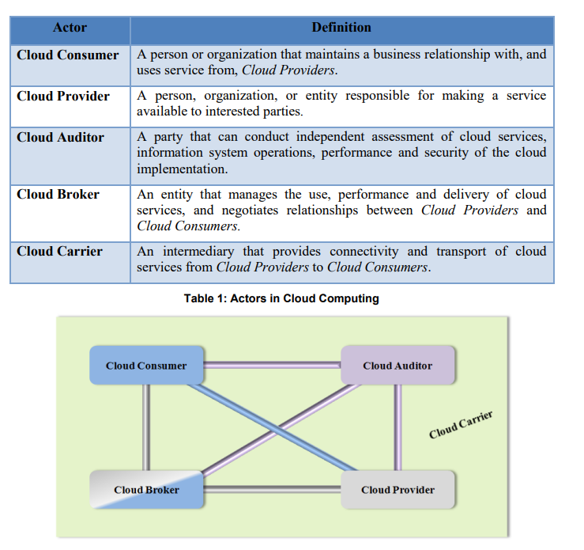
NIST Cloud Computing Reference Architecture

Slide 14
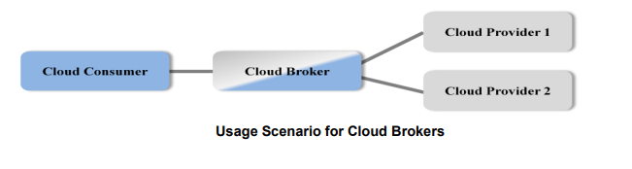
NIST Cloud Computing Reference Architecture
Example Usage Scenario 1: A cloud consumer may request service from a cloud broker instead of contacting a cloud provider directly. The cloud broker may create a new service by combining multiple services or by enhancing an existing service. In this example, the actual cloud providers are invisible to the cloud consumer and the cloud consumer interacts directly with the cloud broker.

Slide 15
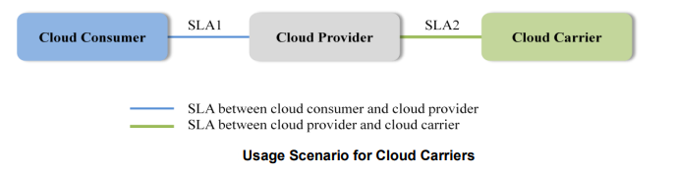
NIST Cloud Computing Reference Architecture
Example Usage Scenario 2:
Cloud carriers provide the connectivity and transport of cloud services from cloud providers to cloud consumers. As illustrated in Figure 4, a cloud provider participates in and arranges for two unique service level agreements (SLAs), one with a cloud carrier (e.g. SLA2) and one with a cloud consumer (e.g. SLA1).
A cloud provider arranges service level agreements (SLAs) with a cloud carrier and may request dedicated and encrypted connections to ensure the cloud services are consumed at a consistent level according to the contractual obligations with the cloud consumers. In this case, the provider may specify its requirements on capability, flexibility and functionality in SLA2 in order to provide essential requirements in SLA1.

Slide 16
NIST Cloud Computing Reference Architecture
Cloud Consumer: The cloud consumer is the principal stakeholder for the cloud computing service. A cloud consumer represents a person or organization that maintains a business relationship with, and uses the service from a cloud provider. A cloud consumer browses the service catalog from a cloud provider, requests the appropriate service, sets up service contracts with the cloud provider, and uses the service. The cloud consumer may be billed for the service provisioned, and needs to arrange payments accordingly.
Cloud Provider: A cloud provider is a person, an organization; it is the entity responsible for making a service available to interested parties. A Cloud Provider acquires and manages the computing infrastructure required for providing the services, runs the cloud software that provides the services, and makes arrangement to deliver the cloud services to the Cloud Consumers through network access.

Slide 17
NIST Cloud Computing Reference Architecture
Cloud Auditor: A cloud auditor is a party that can perform an independent examination of cloud service controls with the intent to express an opinion thereon. Audits are performed to verify conformance to standards through review of objective evidence. A cloud auditor can evaluate the services provided by a cloud provider in terms of security controls, privacy impact, performance, etc.
Cloud Broker: As cloud computing evolves, the integration of cloud services can be too complex for cloud consumers to manage. A cloud consumer may request cloud services from a cloud broker, instead of contacting a cloud provider directly. A cloud broker is an entity that manages the use, performance and delivery of cloud services and negotiates relationships between cloud providers and cloud consumers.

Slide 18
NIST Cloud Computing Reference Architecture
Cloud Carrier: A cloud carrier acts as an intermediary that provides connectivity and transport of cloud services between cloud consumers and cloud providers. Cloud carriers provide access to consumers through network, telecommunication and other access devices.
For example, cloud consumer through network access devices, such as computers, laptops, mobile phones, mobile Internet devices (MIDs), etc.
The distribution of cloud services is normally provided by network and telecommunication carriers or a transport agent , where a transport agent refers to a business organization that provides physical transport of storage media such as high-capacity hard drives.
Note that a cloud provider will set up SLAs with a cloud carrier to provide services consistent with the level of SLAs offered to cloud consumers, and may require the cloud carrier to provide dedicated and secure connections between cloud consumers and cloud providers can obtain cloud services

Slide 19
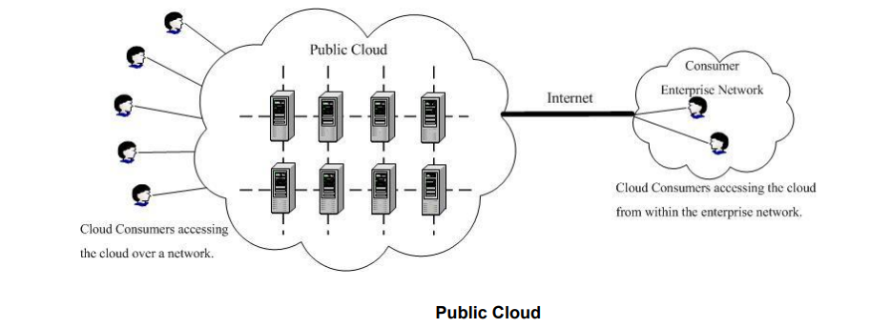
Public, Private and Hybrid Clouds
A public cloud is one in which the cloud infrastructure and computing resources are made available to the general public over a public network. A public cloud is owned by an organization selling cloud services, and serves a diverse pool of clients. Figure below presents a simple view of a public cloud and its customers.

Slide 20
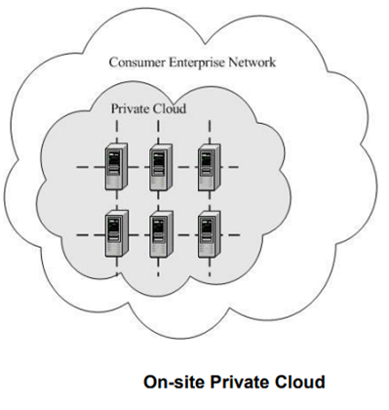
Public, Private and Hybrid Clouds
A private cloud gives a single Cloud Consumer‟s organization the exclusive access to and usage of the infrastructure and computational resources.
It may be managed either by the Cloud Consumer organization or by a third party, and may be hosted on the organization‟s premises (i.e. on-site private clouds) or outsourced to a hosting company (i.e. outsourced private clouds).

Slide 21
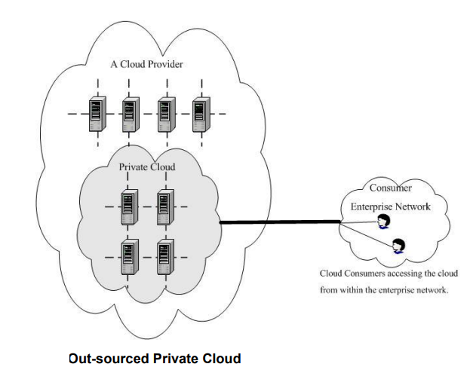
Public, Private and Hybrid Clouds
A community cloud serves a group of Cloud Consumers which have shared concerns such as mission objectives, security, privacy and compliance policy, rather than serving a single organization as does a private cloud.
Similar to private clouds, a community cloud may be managed by the organizations or by a third party, and may be implemented on customer premise (i.e. on-site community cloud) or outsourced to a hosting company (i.e. outsourced community cloud)

Slide 22
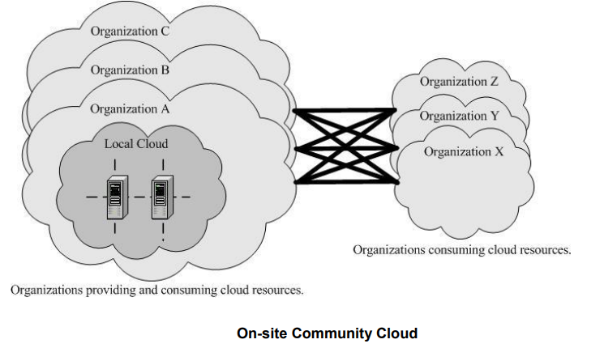
Public, Private and Hybrid Clouds
An on-site community cloud comprised of a number of participant organizations.
A cloud consumer can access the local cloud resources, and also the resources of other participating organizations through the connections between the associated organizations.
Figure shows an outsourced community cloud, where the server side is outsourced to a hosting company.
In this case, an outsourced community cloud builds its infrastructure off premise, and serves a set of organizations that request and consume cloud services

Slide 23
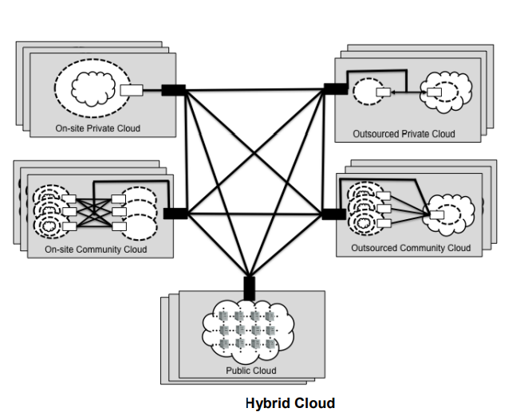
Public, Private and Hybrid Clouds
A hybrid cloud is a composition of two or more clouds (on-site private, on-site community, off-site private, off-site community or public) that remain as distinct entities but are bound together by standardized or proprietary technology that enables data and application portability.
Figure presents a simple view of a hybrid cloud that could be built with a set of clouds in the five deployment model variants

Slide 24
laaS – PaaS – SaaS
SaaS services: o Email and Office Productivity: Applications for email, word processing, spreadsheets, presentations, etc. o
Billing: Application services to manage customer billing based on usage and subscriptions to products and services.
Customer Relationship Management (CRM): CRM applications that range from call center applications to sales force automation.
Collaboration: Tools that allow users to collaborate in workgroups, within enterprises, and across enterprises.
Content Management: Services for managing the production of and access to content for web-based applications.
Document Management: Applications for managing documents, enforcing document production workflows, and providing workspaces for groups or enterprises to find and access documents.
Financials: Applications for managing financial processes ranging from expense processing and invoicing to tax management.
Human Resources: Software for managing human resources functions within companies.
Sales: Applications that are specifically designed for sales functions such as pricing, commission tracking, etc.
Social Networks: Social software that establishes and maintains a connection among users that are tied in one or more specific types of interdependency.
Enterprise Resource Planning (ERP): Integrated computer-based system used to manage internal and external resources, including tangible assets, financial resources, materials, and human resources.

Slide 25
laaS – PaaS – SaaS
PaaS Services:
Business Intelligence: Platforms for the creation of applications such as dashboards, reporting systems, and data analysis.
Database: Services offering scalable relational database solutions or scalable non-SQL datastores.
Development and Testing: Platforms for the development and testing cycles of application development, which expand and contract as needed.
Integration: Development platforms for building integration applications in the cloud and within the enterprise.
Application Deployment: Platforms suited for general purpose application development. These services provide databases, web application runtime environments, etc.

Slide 26
laaS – PaaS – SaaS
IaaS
Backup and Recovery: Services for backup and recovery of file systems and raw data stores on servers and desktop systems.
Compute: Server resources for running cloud-based systems that can be dynamically provisioned and configured as needed.
Content Delivery Networks (CDNs): CDNs store content and files to improve the performance and cost of delivering content for web-based systems.
Services Management: Services that manage cloud infrastructure platforms. These tools often provide features that cloud providers do not provide or specialize in managing certain application technologies.
Storage: Massively scalable storage capacity that can be used for applications, backups, archival, and file storage.

Slide 27
Architectural Design Challenges
Portability
Cost
Interoperability
Downtime
Multi Cloud Environments
High Dependence on network

Slide 28
Cloud Storage
Cloud storage delivers cost-effective, scalable storage.
No longer need to worry about running out of capacity, maintaining storage area networks (SANs), replacing failed devices, adding infrastructure to scale up with demand, or operating underutilized hardware when demand decreases.
Cloud storage is a cloud computing model that enables storing data and files on the internet through a cloud computing provider that you access either through the public internet or a dedicated private network connection.

Slide 29
Cloud Storage
Types of cloud storage
Object storage
Organizations have to store a massive and growing amount of unstructured data, such as photos, videos, machine learning (ML), sensor data, audio files, and other types of web content, and finding scalable, efficient, and affordable ways to store them can be a challenge.
Object storage is a data storage architecture for large stores of unstructured data.
Objects store data in the format it arrives in and makes it possible to customize metadata in ways that make the data easier to access and analyze.

Slide 30
Cloud Storage
File storage
File-based storage or file storage is widely used among applications and stores data in a hierarchical folder and file format.
This type of storage is often known as a network-attached storage (NAS) server with common file level protocols of Server Message Block (SMB) used in Windows instances and Network File System (NFS) found in Linux.

Slide 31
Cloud Storage
Block storage
Enterprise applications like databases or enterprise resource planning (ERP) systems often require dedicated, low-latency storage for each host.
This is analogous to direct-attached storage (DAS) or a storage area network (SAN).
In this case, you can use a cloud storage service that stores data in the form of blocks. Each block has its own unique identifier for quick storage and retrieval.

Slide 32
Storage As A Service
Storage as a service (STaaS) is a managed service in which the provider supplies the customer with access to a data storage platform.
The service can be delivered on premises from infrastructure that is dedicated to a single customer, or it can be delivered from the public cloud as a shared service that's purchased by subscription and is billed according to one or more usage metrics.
STaaS customers access individual storage services through standard system interface protocols or application program interfaces (APIs).
Typical offerings include bare-metal storage capacity; raw storage volumes; network file systems; storage objects; and storage applications that support file sharing and backup lifecycle management.

Slide 33
Storage As A Service
Storage as a service (STaaS) is a managed service in which the provider supplies the customer with access to a data storage platform.
The service can be delivered on premises from infrastructure that is dedicated to a single customer, or it can be delivered from the public cloud as a shared service that's purchased by subscription and is billed according to one or more usage metrics.
STaaS customers access individual storage services through standard system interface protocols or application program interfaces (APIs).
Typical offerings include bare-metal storage capacity; raw storage volumes; network file systems; storage objects; and storage applications that support file sharing and backup lifecycle management.

Slide 34
Storage As A Service
Advantages of STaaS
Key advantages to STaaS in the enterprise include the following:
Storage costs. Personnel, hardware and physical storage space expenses are reduced.
Disaster recovery. Having multiple copies of data stored in different locations can better enable disaster recovery measures.
Scalability. With most public cloud services, users only pay for the resources that they use.
Syncing. Files can be automatically synced across multiple devices.
Security. Security can be both an advantage and a disadvantage, as security methods may change per vendor. Data tends to be encrypted during transmission and while at rest.

Slide 35
Cloud Storage Providers
Other public cloud vendors with cloud storage services include the following:
Amazon Web Services (AWS)
Microsoft Azure
Google Cloud
Oracle cloud
Box
Arcserve

Slide 36
Storage As A Service
Other public cloud vendors with cloud storage services include the following:
Amazon Web Services (AWS)
Microsoft Azure
Google Cloud
Oracle cloud
Box
Arcserve
Before choosing a service method, an organization should consider the location of the data center, its security methods, cost, performance, availability, scalability and potential of vendor lock-in.

Slide 37
S3 In Cloud
The S3 storage classes include S3 Intelligent-Tiering for automatic cost savings for data with unknown or changing access patterns, S3 Standard for frequently accessed data, S3 Standard-Infrequent Access (S3 Standard-IA) and S3 One Zone-Infrequent Access (S3 One Zone-IA) for less frequently accessed data, S3 Glacier Instant Retrieval for archive data that needs immediate access, S3 Glacier Flexible Retrieval (formerly S3 Glacier) for rarely accessed long-term data that does not require immediate access, and Amazon S3 Glacier Deep Archive (S3 Glacier Deep Archive) for long-term archive and digital preservation with retrieval in hours at the lowest cost storage in the cloud.
If you have data residency requirements that can’t be met by an existing AWS Region, you can use the S3 Outposts storage class to store your S3 data on premises. Amazon S3 also offers capabilities to manage your data throughout its lifecycle. Once an S3 Lifecycle policy is set, your data will automatically transfer to a different storage class without any changes to your application.

Slide 38
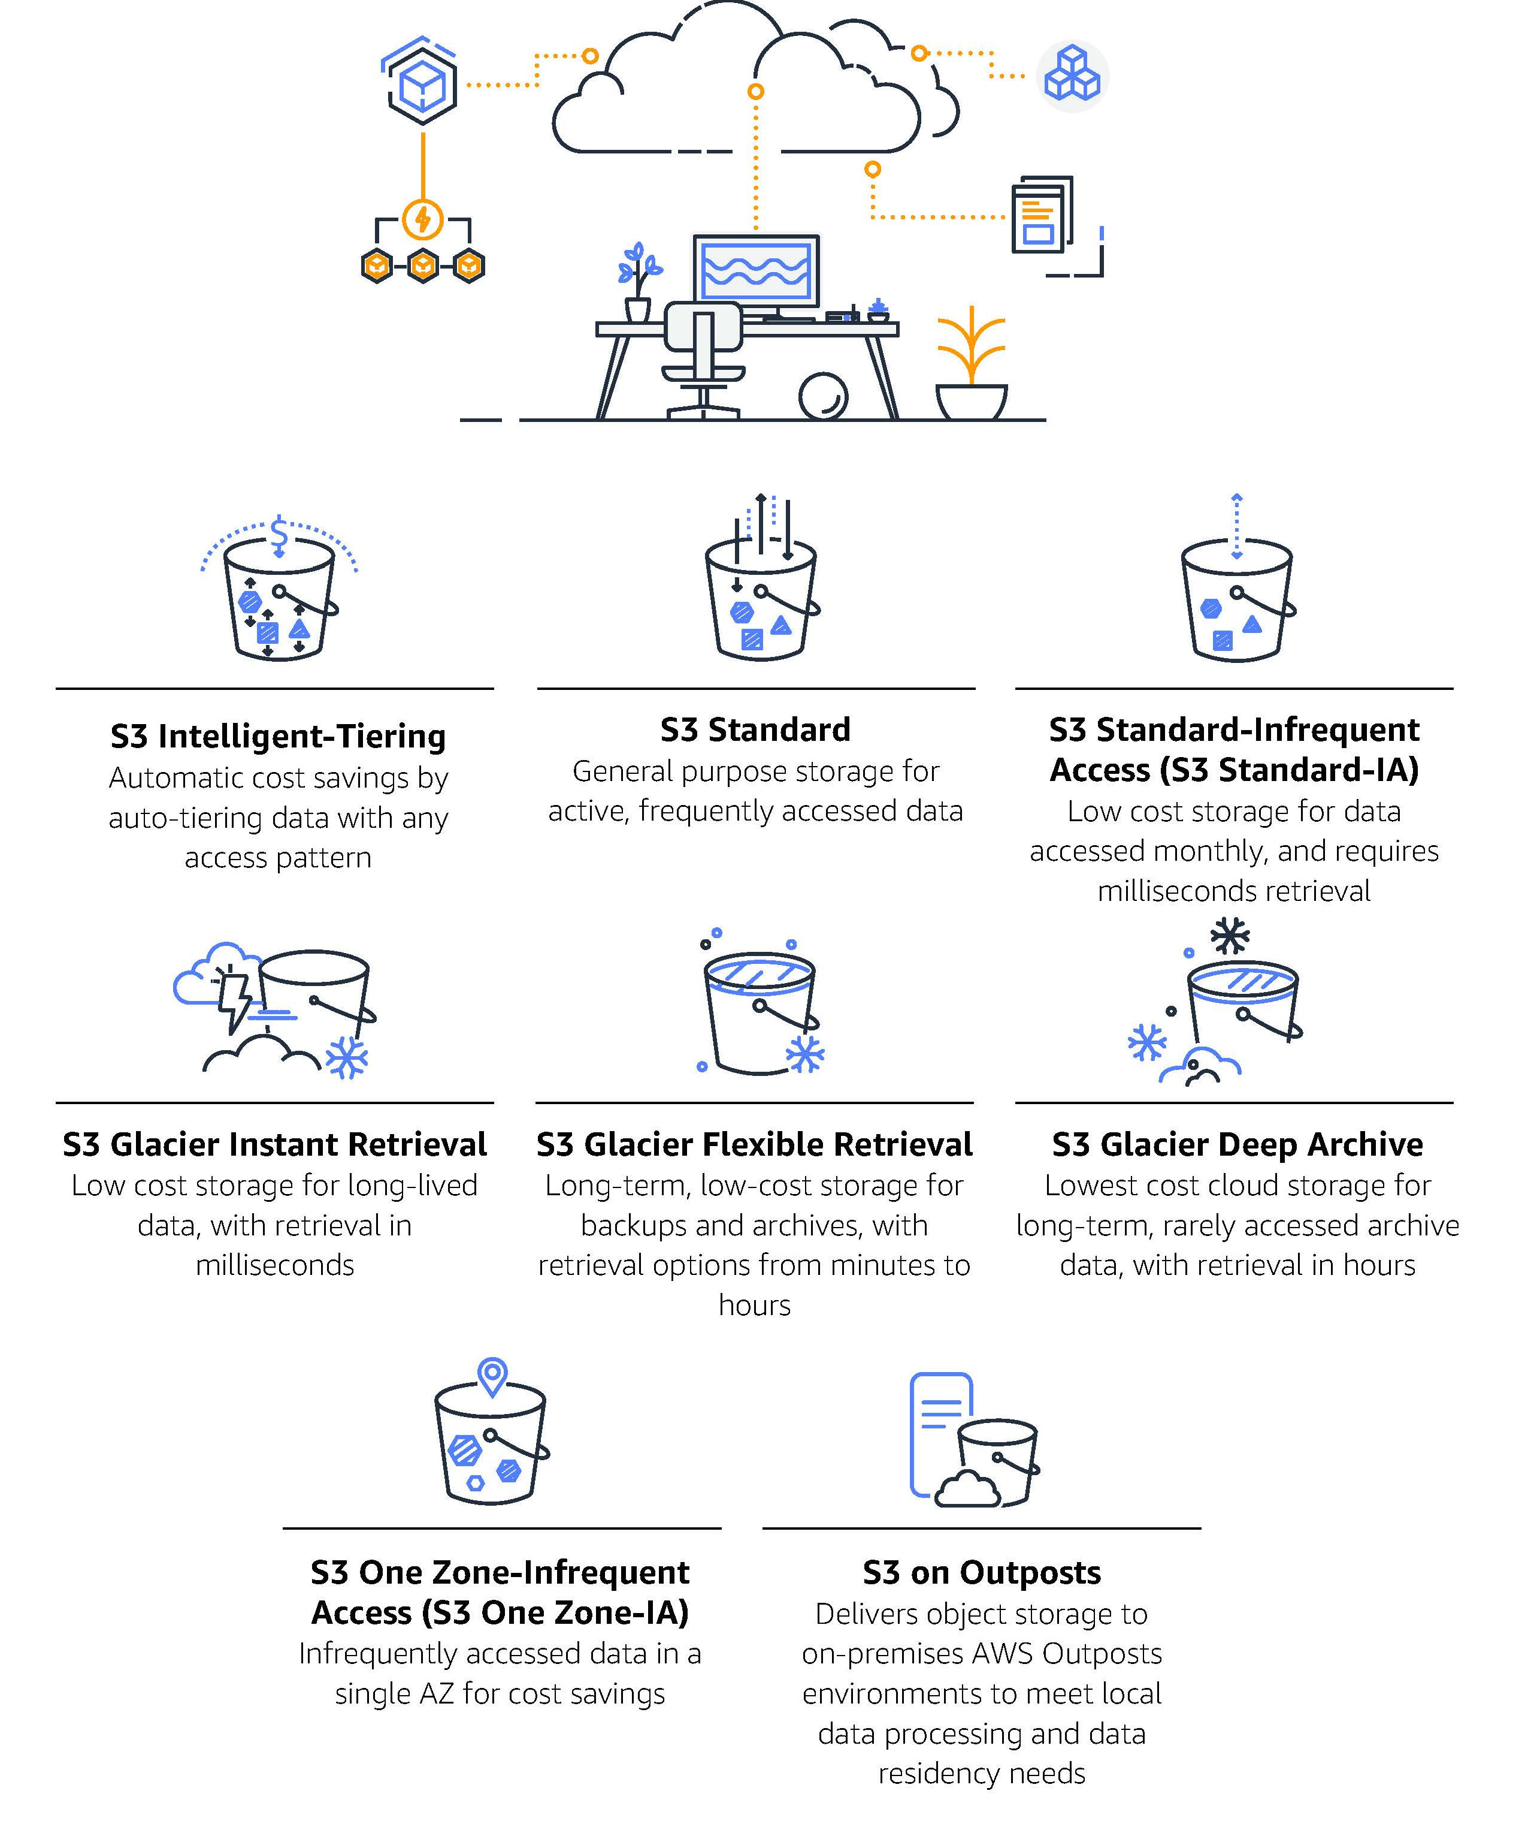
S3 In Cloud

